Slide 1
Collaborative Quantum Software Stack
Enabling Hybrid Execution, Pulse-Level Digital Twins, and CUDA-Q Ecosystem Expansion
Tan Kai Yong Andy, Khoo Jun Yong
Institute of High Performance Computing (IHPC), ASTAR
10 Mar 2025

Slide 2
Agenda
Hybrid Quantum Execution Environment
Cloud Software
Integration of CUDA-Q with Qibo
Pulse-Level Emulator for CUDA-Q Expansion
Pulse-Level Control of Anyon QPU
End-to-End User Application Demo
Notes:
Introduction to Hybrid Quantum Execution Environment
Cloud Software linked to CUDA-Q – User & workload management
Integration of CUDA-Q with Qibo – Optimized execution
Pulse-Level Emulator – Hardware proxy for pre-execution optimization
Pulse-Level Control of Anyon QPU – Direct manipulation of quantum hardware
End-to-End User Application Demo – Real-world hybrid quantum computing example

Slide 3
Hybrid Quantum Execution Environment
Collaborating with Anyon Technologies
Fully integrated solution to bridge gap b/w quantum HW and industrial applications.
Leveraging AWS Cloud, CUDA-Q & Qibo
Scalable, accurate, and industry-optimized software stack enabling seamless end-to-end quantum algorithm deployment across finance, logistics, AI, and drug discovery
Cloud UI
(AWS cloud)
HQCC Middleware
(CUDA-Q)
Pulse-level Emulation
(Qibolab)
Pulse-level QPU Calibration and Control
(Qibocal & Qibolab)
Quantum Software Stack
Notes:
(1-2 Minutes):
Industry Needs & Challenges
Our solution
Is a fully integrated Hybrid Quantum Execution Environment designed to bridge the gap between quantum hardware and industrial applications. (talk about industry having the use case but no know how and hw challenge of noise and error reduction etc...)
To achieve this, we are collaborating with Anyon Technologies to develop a comprehensive quantum software stack that seamlessly integrates quantum and classical computing resources.
Explain fig:
We start with CUDA-Q, which provides a powerful framework for hybrid quantum-classical computing (HQCC) and GPU-accelerated quantum simulation.
We enhance CUDA-Q with a user-friendly cloud interface through AWS Cloud, enabling seamless job scheduling, workload management, and backend selection.
Finally, we extend it further with Qibo, adding pulse-level emulation, calibration, and QPU control to fine-tune quantum hardware and improve computational accuracy.
Key Benefits:
This integrated software stack is designed to be scalable, accurate, and optimized for industrial applications across finance, logistics, AI, and drug discovery.
By leveraging these cutting-edge platforms, we enable seamless end-to-end quantum algorithm deployment—from simulation and emulation to execution on real quantum processors.
Could be used by industry companies like HSBC
We will show you more details in next few slides

Slide 4
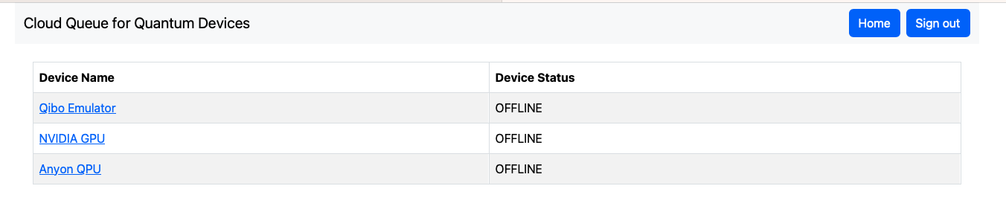
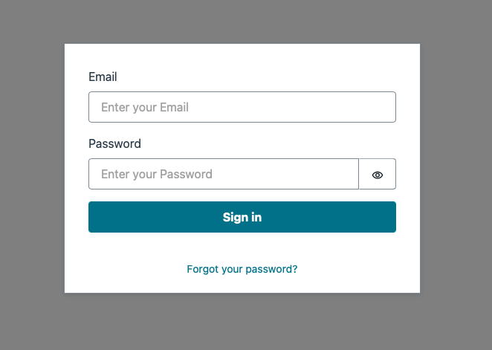
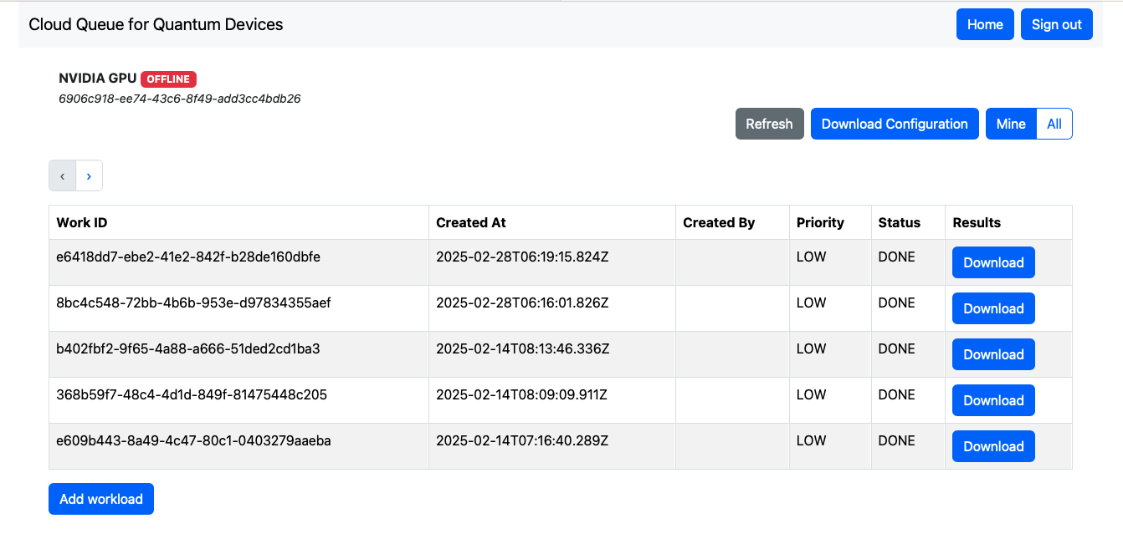
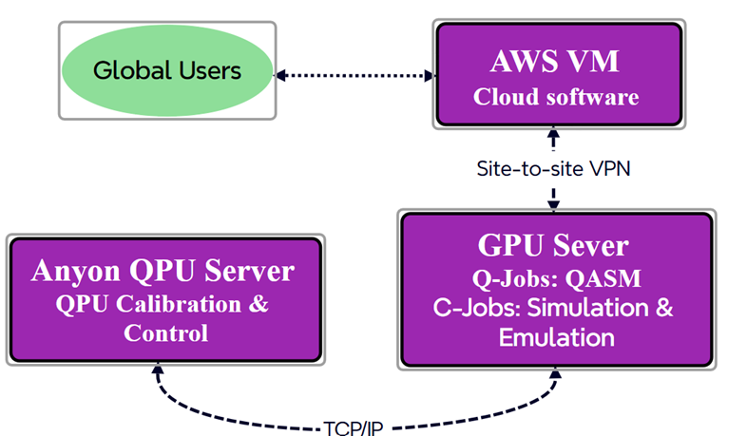
Cloud Software
Builds upon open-source AWS Cloud Queue for Quantum Devices and SideQICK software
Frontend → web interface:
User, device and job management system
Backend → Job Processing Engine with SideQICK:
CUDA-Q GPU
Emulator
Anyon QPU
List of devices available
User log in
Job status and result download
Brief architecture overview of software stack

Slide 5
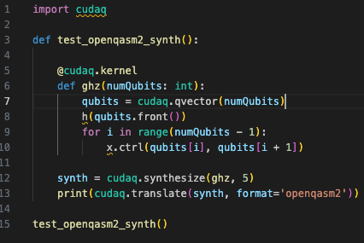
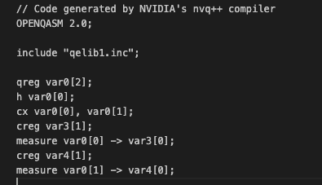
Integration of CUDA-Q with Qibo
CUDA-Q <-> Qibo interface
As a proof of concept, and to allow quick workflow validation, decision is to
Use of OpenQASM2.0, which is supported by both libraries.
Utilize the CUDA-Q translate API for conversion.
End product: A functional interface enabling interoperability between CUDA-Q and Qibo,
In the future, we can explore deeper integration, such as at the IR level, to enable more seamless integration.
Qibo/Qibolab
Sample CUDA-Q script
OpenQASM.txt

Slide 6
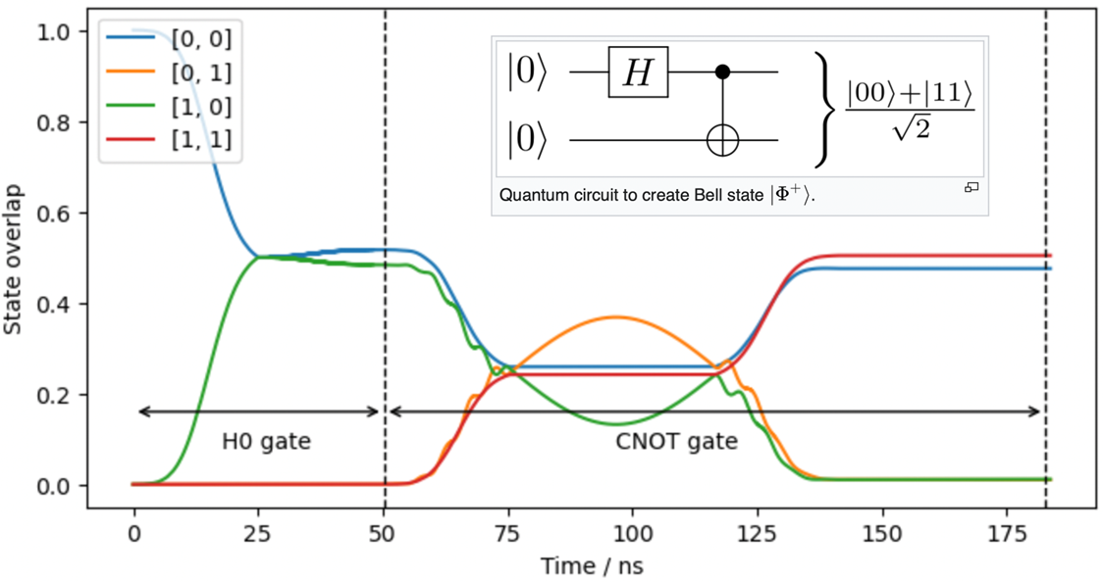
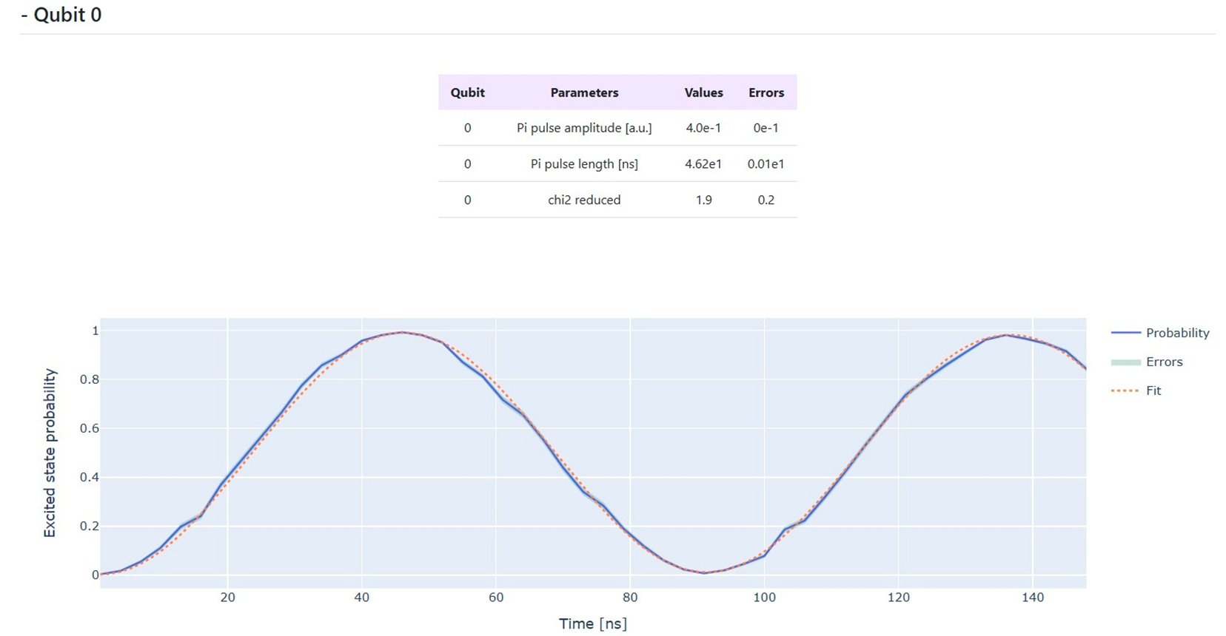
Qibolab Emulator for CUDA-Q Expansion
Enables simulation of CUDA-Q circuits at the pulse level, incorporating decoherence effects and instrument limitations
Provides pulse-level control beyond gates and circuits, and mimics the corresponding hardware setup
Compatible with Qibocal calibration tools
Notes:
Introducing the Qibolab emulator and our recent efforts to integrate it with CUDA-Q to expand the CUDA-Q ecosystem.

Slide 7
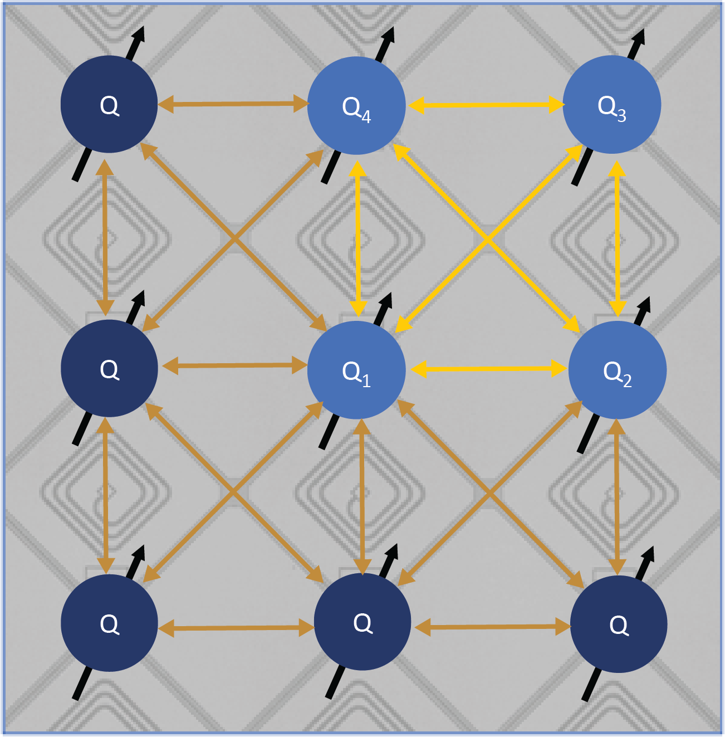

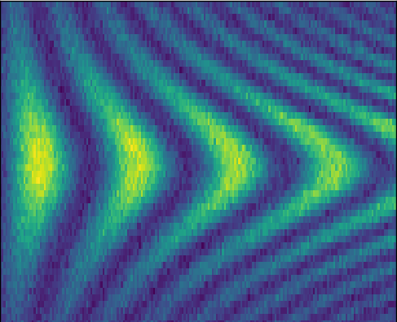
Anyon Parametric 2-Qubit Gate
Fixed frequency qubits with tunable couplers.
Fixed frequency qubits provides great coherence, and tunable couplers provides flexibility.
High-connectivity between up to 9 qubits in a directly connected group.
Modulated parametric drive on the coupler, to turn on the specific qubit-pair coupling
A complete implementation of the Fermionic simulation (fSim) gate set
iSWAP-like gate and controlled-phase gate
Connectivity = 8
Parametric Drive Freq
Parametric Drive Freq
Gate-time [ns]
Gate-time [ns]
Notes:
A typical strategy has been to demonstrate a minimally universal gate set consisting of arbitrary single-qubit rotations and a single two-qubit gate. However, many noisy intermediate-scale quantum (NISQ) algorithms require a more diverse set of two-qubit gates.
An implementation of these gates could take the place of six to eight single-qubit gates and three CZ gates per arbitrary two-qubit gate required with an optimal decomposition into a minimally universal gate set
Taking advantage of the adjustable coupling of parametric couplers, Anyon’s latest QPUs have the potential to achieve a continuous two-qubit gate set that can provide a threefold reduction in circuit depth as compared to a standard decomposition.
Two gate families can be implemented: an iSWAP-like gate to attain an arbitrary swap angle, and a controlled-phase gate that generates an arbitrary conditional phase.
Using one of each of these gates, Anyon QPUs can perform an arbitrary two-qubit gate within the excitation-preserving subspace allowing for a complete implementation of the so-called Fermionic simulation (fSim) gate set.
Chevrons are experimental data, very clean swap between qubits.

Slide 8
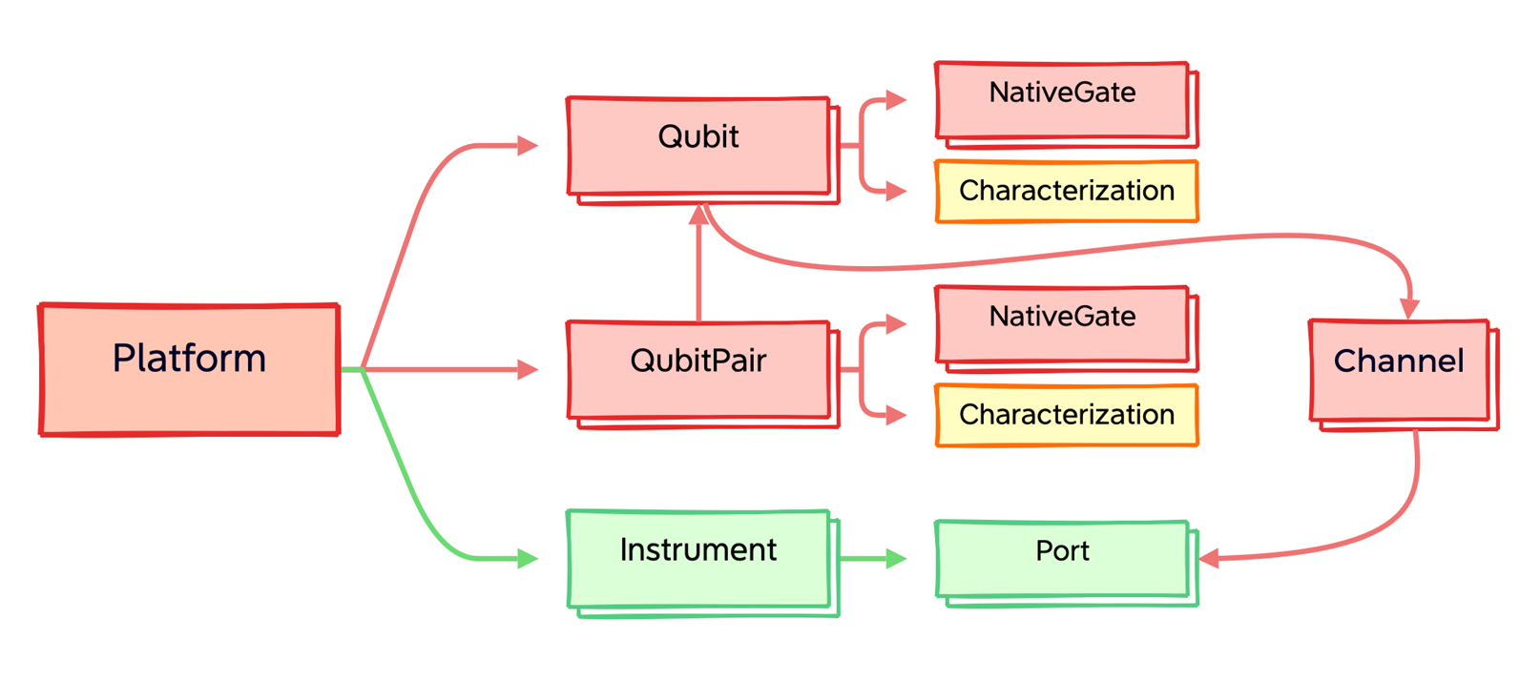
Pulse-level Control of Anyon QPU
Development of Qibolab driver for Anyon's control electronics to enable:
Execution of pulse sequences on Anyon QPUs through Qibolab
QPU calibration via Qibocal
Notes:
As we have shown, Qibolab is an open-source software that provides pulse-level control so that it is natural to host the pulse-level emulator there.
To complete the chain, as part of this collaboration, we connect Anyon QPUs to Qibolab by developing the Qibolab driver that directly communicates with Anyon’s internally developed control electronics.
This requires close collaboration between software developers and QPU control system hardware engineers to understand the communication protocols of instruments and parameters in the control electronics.
The Qibolab driver is designed to adopt the same protocols as the hardware control electronics, optimizing the setup of instruments, ports and channels in Qibolab that are used to connect and communicate with the qubits.

Slide 9
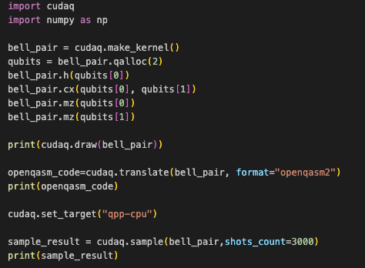
End-to-End User Application Demo
Bell Test script
Device tested:
CUDA-Q simulation
Qibolab emulator (3k shots)
Anyon QPU (3k shots)
Test Case: Bell Test
https://dev.d20ltewlvhbegi.amplifyapp.com/
Expected result Counter({ 00:1485 11:1515 })
Notes:
https://dev.d20ltewlvhbegi.amplifyapp.com/

Slide 10
Acknowledgments
IHPC A*STAR
Khoo Jun Yong
Tan Kai Yong Andy
Bai Ping
Ye Jun
Yang Liwei
Anyon Technologies
Jie (Roger) Luo
Shuyi Liu
Theo Luo
Software platforms
CUDA-Q
Qibo (Qibocal, Qibolab)
AWS Cloud Queue for Quantum Devices (SideQICK)
Funding Support
National Quantum Computing Hub

Slide 11
Thanks

